Slide 1

Part II Computability Theory
decidability

Slide 2
Hilbert’s Tenth Problem
Let D = {p | p is a polynomial with an integral root}.
Hilbert’s tenth problem (rephrased): “Is there an algorithm for determining D?”
A polynomial is a sum of terms, where each term is a product of variables and a constant.
For example, 6x³yz² + 3xy² − x³ − 10 is a polynomial with four terms over variables x, y, and z.
Proving that no algorithm exists for a particular task requires a precise definition of algorithm

Slide 3
Original Statement of Hilbert
10. Determination of the solvability of a Diophantine equation.
“Given a Diophantine equation with any number of unknown quantities and with rational integral numerical coeﬃcients: To devise a process according to which it can be determined by a ﬁnite number of operations whether the equation is solvable in rational integers”

Slide 4
Definition of Algorithm
In the early 20th century, an algorithm was intuitively understood as a “well-deﬁned procedure”.
However, this deﬁnition lacked mathematical rigor.
Alonzo Church and Alan Turing each developed a methodology for deﬁning an algorithm rigorously, in the 1930’s.

Slide 5
The Church-Turing Thesis
Alonzo Church gave λ-calculus to deﬁne his notion of algorithms.
λ-calculus is the foundation of modern functional programming.
Alan Turing gave Turing machines to deﬁne his notion of an algorithm.
These two notions of algorithms were shown to be equivalent.
The connection between the “intuitive” notion of algorithms and Turing-machine algorithms is the Church-Turing thesis.
Any algorithm we can devise can be carried out on a Turing machine.

Slide 6
Back to Hilbert’s Problem
Let D = {p| p is a polynomial with an integral root}
Hilbert’s tenth problem asks in essence whether the set D is decidable. The answer is no.
In contrast, we can show that D is Turing-recognizable
First we consider a simpler problem with only single variable and construct a TM for it.
Let D₁= {p| p is a polynomial over x with an integral root}

Slide 7
Back to Hilbert’s Problem …
Here is a TM M₁ that recognizes D₁:
M₁ = “On input <p>: where p is a polynomial over the variable x.
Evaluate p with x set successively to the values 0, 1, −1, 2, −2,
3,−3, .. . If at any point the polynomial evaluates to 0, accept .”
If p has an integral root,M₁ eventually will find it and accept. If p does not have an integral root, M₁ will run forever.
For the multivariable case, construct a similar TM M that recognizes D. Here, M goes through all possible settings of its variables to integral values.
Both M₁ and M are recognizers but not deciders.

Slide 8
Decision Problems
Decision problem - a set of related questions each having a yes/no answer
Examples:
given a natural number n, is n even?
given a language L and a string u, is u ∈ L?
Decidability:
A decision problem is decidable (or solvable) if there exists an algorithm that spits out, for every instance of the problem, the correct answer.
Surely every decision problem is decidable ?
Do undecidable problems exist ?

Slide 9
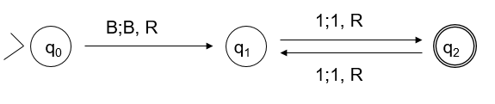
More on Decidability
Church-Turing idea that algorithms are Turing machines, we re-cast each decision problem as a ‘membership in a language’ problem.
Then the decision problem is decidable iff the language associated with the problem is recursive.
Problem: given natural number n, is n even?
Language: L = {1^{n} | n is odd}
A Turing machine that accepts L and halts on every input solves the decision problem —
if n ∈ L the TM halts in a final state on input string n, telling us that n is even
if n ∉ L the TM halts in a non-final state.

Slide 10
Gödel-coding of TMs
Let M=
M accepts strings n that represent even natural numbers.
To encode M’s symbols: use 0s as separators and
let input symbol 0 be coded as 1, symbol 1 as 11, and symbol B as 111
let state q₀ be encoded as 1, state q₁ as 11, and state q₂ as 111
let move L be 1, move R be 11.

Slide 11
Gödel-coding of TMs……
The encoded transitions become
δ(q₀, B) = [q₁, B, R] 101110110111011
δ(q₁, 1) = [q₂, 1, R] 110110111011011
δ(q₂, 1) = [q₁, 1, R] 111011011011011
Between transitions use 00, to begin and end use 000.
So the string representing M is R(M) =
001011101101110110011011011101101100111011011011011000

Slide 12
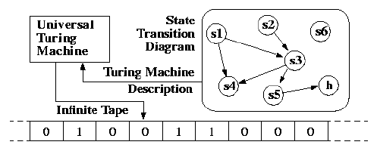
Universal Turing Machine
- It takes a description of a machine and input on its tape and it simulates the behavior of the given Turing Machine.

